Slide 1

Object Streams
Object Graphs
Serializable
Serial Versions
Transient Data

Slide 2

See Also
https://docs.oracle.com/javase/tutorial/essential/io/objectstreams.html
https://www.youtube.com/watch?v=SJBt5l9OvWQ

Slide 3
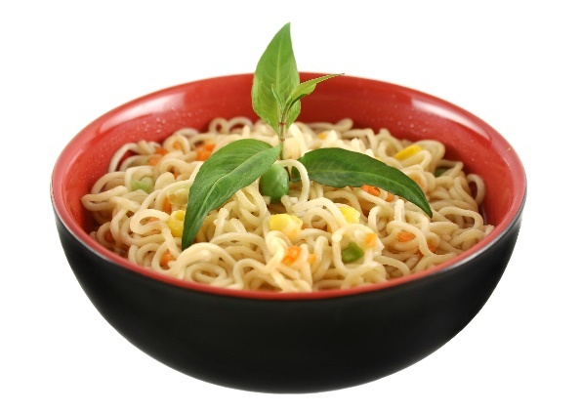
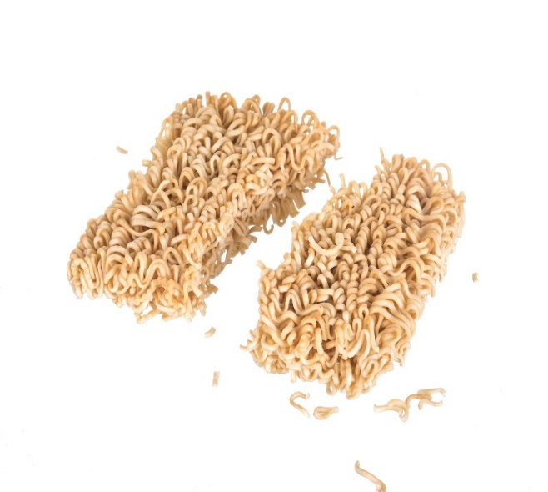
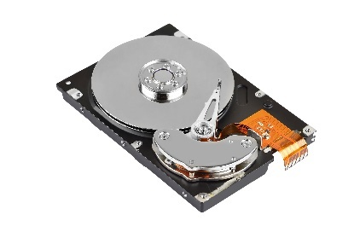
Serialization
Noodle
Noodle
1
0
1
1
Most of the object details are in the class file
Convert object to a stream of bytes (dehydrate)
Then back to an object (rehydrate)
Streams of bytes … two ways (into your program and out of your program)
Disks, consoles, sockets, keyboards, printers
Know how to talk streams and you can talk to anything
Initialization (constructor) is different. Use is the same.

Slide 4
Serialization
00
00
01
25
00
00
00
80
Binary
Point:
int x = 293
int y = 128
‘2’
‘9’
‘3’
‘,’
‘1’
‘2’
‘8’
Text
<Point><x>293</x><y>128</y></Point>
XML
{“x”:293, “y”:128}
JSON
Many formats to choose
Streams of bytes … two ways (into your program and out of your program)
Disks, consoles, sockets, keyboards, printers
Know how to talk streams and you can talk to anything
Initialization (constructor) is different. Use is the same.

Slide 5
Object References
Point:
int x = 4
int y = 3
4,3
Line:
Point a
Point b
4
3
0
0
0
0
5
8
0,0
Point:
int x = 0
int y = 0
0,0
Line:
Point a
Point b
4
3
0
0
ref
5
8
5,8
Point:
int x = 5
int y = 8
Streams of bytes … two ways (into your program and out of your program)
Disks, consoles, sockets, keyboards, printers
Know how to talk streams and you can talk to anything
Initialization (constructor) is different. Use is the same.

Slide 6
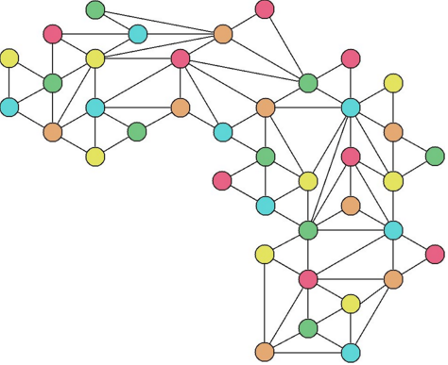
Object Graphs
Simple trees: you may not need to worry
General case: complex object graphs with lots of circular paths
Streams of bytes … two ways (into your program and out of your program)
Disks, consoles, sockets, keyboards, printers
Know how to talk streams and you can talk to anything
Initialization (constructor) is different. Use is the same.

Slide 7
Point and Line
public class Point {
public int x;
public int y;
public Point(int x, int y) {
this.x = x;
this.y = y;
}
@Override
public String toString() {
return "("+x+","+y+")";
}
}
public class Line {
public Point a;
public Point b;
public Line(Point a, Point b) {
this.a = a;
this.b = b;
}
@Override
public String toString() {
return "["+a+"-"+b+"]";
}
}
Streams of bytes … two ways (into your program and out of your program)
Disks, consoles, sockets, keyboards, printers
Know how to talk streams and you can talk to anything
Initialization (constructor) is different. Use is the same.

Slide 8
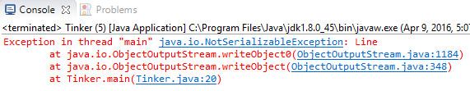
Object Streams
public class Tinker {
public static void main(String [] args) throws Exception {
Point a = new Point(4,3);
Point b = new Point(0,0);
Point c = new Point(5,8);
Line x = new Line(a,b);
Line y = new Line(b,c);
OutputStream os = new FileOutputStream("test.bin");
ObjectOutputStream oos = new ObjectOutputStream(os);
oos.writeObject(x);
oos.writeObject(y);
oos.flush();
oos.close();
}
}
Streams of bytes … two ways (into your program and out of your program)
Disks, consoles, sockets, keyboards, printers
Know how to talk streams and you can talk to anything
Initialization (constructor) is different. Use is the same.

Slide 9
Point and Line
import java.io.Serializable;
import java.io.Serializable;
implements Serializable {
implements Serializable {
public class Line {
public Point a;
public Point b;
public Line(Point a, Point b) {
this.a = a;
this.b = b;
}
@Override
public String toString() {
return "["+a+"-"+b+"]";
}
}
public class Point {
public int x;
public int y;
public Point(int x, int y) {
this.x = x;
this.y = y;
}
@Override
public String toString() {
return "("+x+","+y+")";
}
}
No methods
“tag” interface
Gives permission
Streams of bytes … two ways (into your program and out of your program)
Disks, consoles, sockets, keyboards, printers
Know how to talk streams and you can talk to anything
Initialization (constructor) is different. Use is the same.

Slide 10
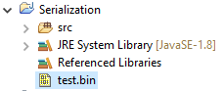

Serializable Interface
public class Tinker {
public static void main(String [] args) throws Exception {
Point a = new Point(0xFACE,0xBEEF);
Point b = new Point(0,0);
Point c = new Point(5,8);
Line x = new Line(a,b);
Line y = new Line(b,c);
OutputStream os = new FileOutputStream("test.bin");
ObjectOutputStream oos = new ObjectOutputStream(os);
oos.writeObject(x);
oos.writeObject(y);
oos.flush();
oos.close();
}
}
Streams of bytes … two ways (into your program and out of your program)
Disks, consoles, sockets, keyboards, printers
Know how to talk streams and you can talk to anything
Initialization (constructor) is different. Use is the same.

Slide 11
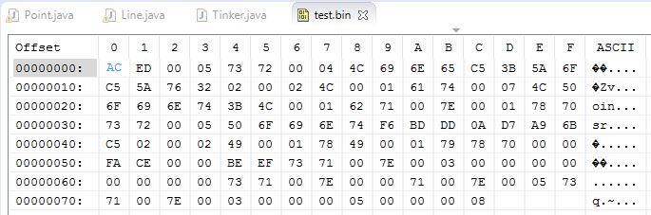

Object Streams
Streams of bytes … two ways (into your program and out of your program)
Disks, consoles, sockets, keyboards, printers
Know how to talk streams and you can talk to anything
Initialization (constructor) is different. Use is the same.

Slide 12
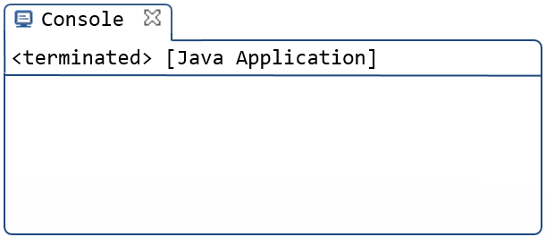
Hydration
public class Tinker {
public static void main(String [] args) throws Exception {
InputStream is = new FileInputStream("test.bin");
ObjectInputStream iis = new ObjectInputStream(is);
Line t = (Line) iis.readObject();
Line u = (Line) iis.readObject();
iis.close();
Point ta = t.a;
Point tb = t.b;
Point ua = u.a;
Point ub = u.b;
System.out.println(t);
System.out.println(u);
ua.x = -1;
ua.y = -1;
System.out.println(t);
System.out.println(u);
}
}
[(64206,48879)-(0,0)]
[(0,0)-(5,8)]
[(64206,48879)-(-1,-1)]
[(-1,-1)-(5,8)]
Streams of bytes … two ways (into your program and out of your program)
Disks, consoles, sockets, keyboards, printers
Know how to talk streams and you can talk to anything
Initialization (constructor) is different. Use is the same.

Slide 13
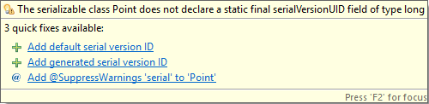
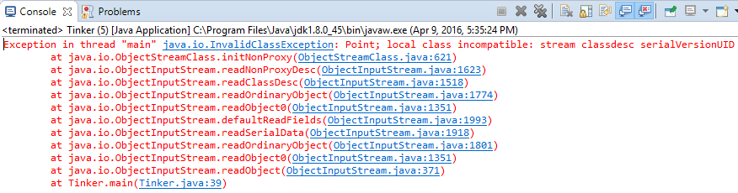
Serial Version
public class Point implements Serializable {
private static final long serialVersionUID = 1;
public int x;
public int y;
public int color;
public Point(int x, int y) {
this.x = x;
this.y = y;
}
@Override
public String toString() {
return "("+x+","+y+"):"+color;
}
}
InputStream is = new FileInputStream("test.bin");
ObjectInputStream iis = new ObjectInputStream(is);
Line t = (Line) iis.readObject();
Streams of bytes … two ways (into your program and out of your program)
Disks, consoles, sockets, keyboards, printers
Know how to talk streams and you can talk to anything
Initialization (constructor) is different. Use is the same.

Slide 14
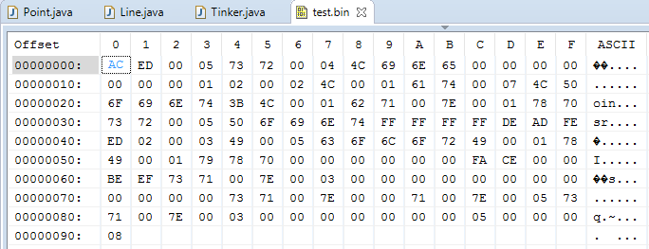
Serial Version
private static final long serialVersionUID = 0xDEAD_FEED;
Streams of bytes … two ways (into your program and out of your program)
Disks, consoles, sockets, keyboards, printers
Know how to talk streams and you can talk to anything
Initialization (constructor) is different. Use is the same.

Slide 15
Transient
public class Point implements Serializable {
private static final long serialVersionUID = 1;
public int x;
public int y;
public int color;
public transient String secretWord;
public Point(int x, int y) {
this.x = x;
this.y = y;
}
@Override
public String toString() {
return "("+x+","+y+"):"+color;
}
}
Transient variables are NOT serialized
Unmarshalled to the “0” state
Streams of bytes … two ways (into your program and out of your program)
Disks, consoles, sockets, keyboards, printers
Know how to talk streams and you can talk to anything
Initialization (constructor) is different. Use is the same.

Slide 16

Serialization
Streams of bytes … two ways (into your program and out of your program)
Disks, consoles, sockets, keyboards, printers
Know how to talk streams and you can talk to anything
Initialization (constructor) is different. Use is the same.

Slide 17

Tinkering
Type in the Point/Line example and run it.
Modify the UDP example to send Lines in the byte array content. Read them out on the other side.
Notes:
Reference the discussion area

